Slide 1
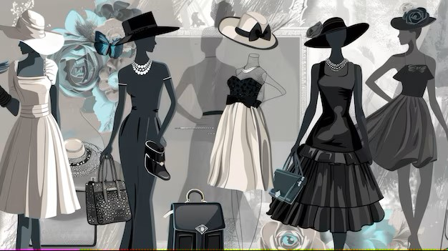

CHERRY+ NETWORK
TEAM NAME- SOL-TECH
TEAM MEMBERS- Januja
Shaan
Akshansh
Mannan
Tanishk
Track – open innovation

Slide 2
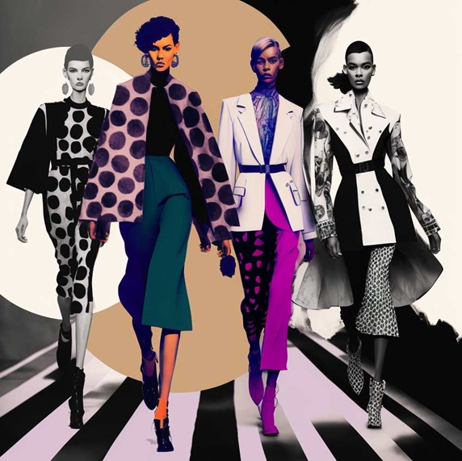
WHAT IS FASHION
STYLING ?
In fashion ,style is a persons way of expressing themselves through their clothing ,accessories ,hair ,makeup and overall asthetics . It’s often referred as “personal style ”. Style can also include how a person puts together an outfit

Slide 3
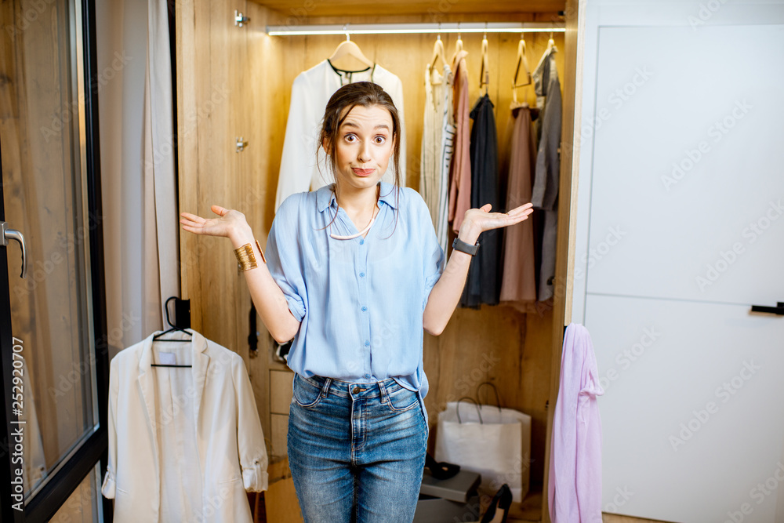
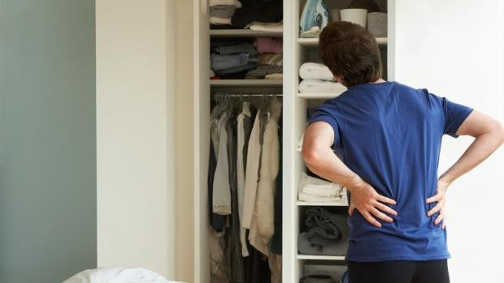
PROBLEMS FACED WHILE FASHION STYLING ?
Even with the overloaded wardrobe, we are always confused what to wear and its matching accessories. For us selecting what to wear is always like discovering a needle in a room full of hay, which often leads to spoiled mood.
“WORRY NOT WE HAVE THE ULTIMATE WARDROBE MANAGEMENT SOLUTION.”

Slide 4
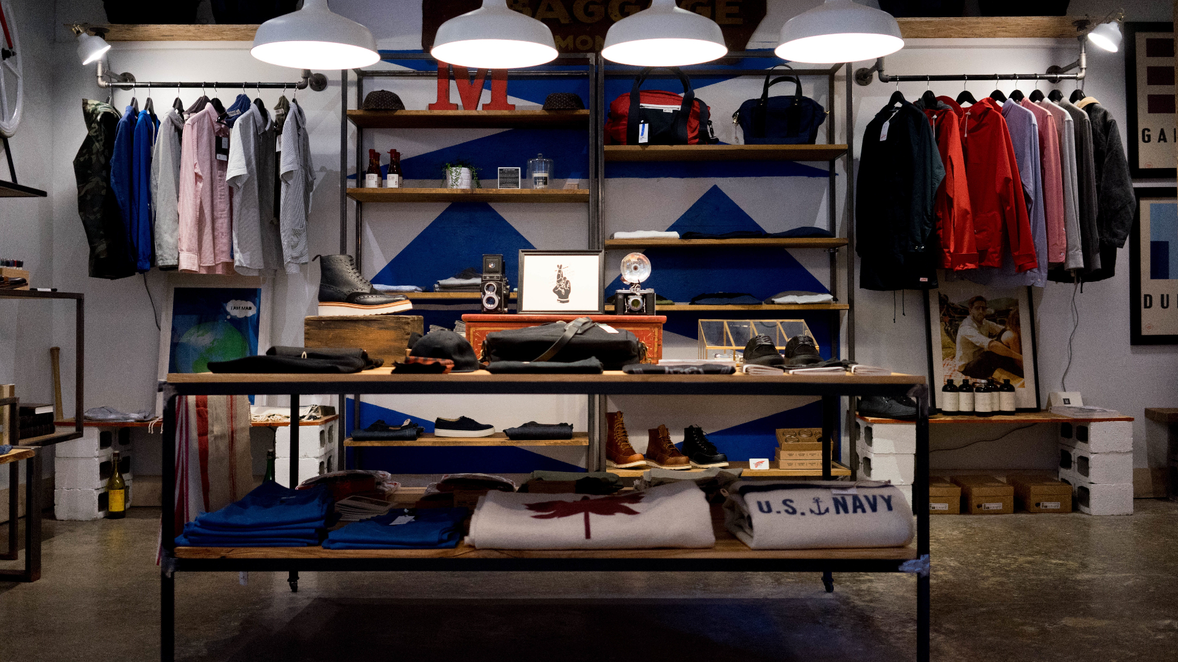
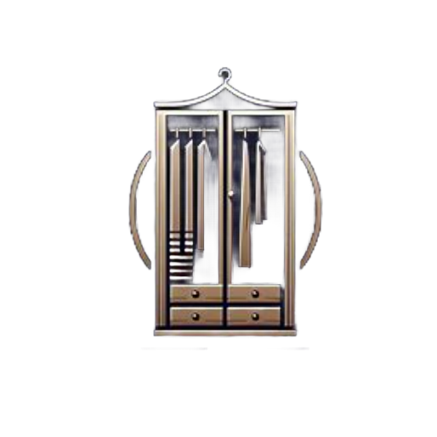
StyleDrobe
“Fashion at your fingertips”
Smart Wardrobe Management: Organize clothes based on your personal schedule.
Maximize Use: Ensure that all clothes get worn and enjoyed.
Effortless Planning: Simplify outfit selection and planning with ease.

Slide 5
StyleDrobe
What it does
Time management: Saves a lot of time and removes confusion
Smart Wardrobe Management: Organize clothes based on your personal schedule.
Maximize Use: Ensure that all clothes get worn and enjoyed with equal intervals.
Effortless Planning: Personlized outfit selection
AI automated selections
Certain Moments: Specific outfits for occasions set or for different weathers.
Add ons: Suggests accessories or clothings on sites.

Slide 6
How it works
Upload Your Wardrobe: Snap pictures or input details of your clothing.
Set Your Schedule: Input daily, weekly, or monthly plans and events.
Get Personalized Recommendations: Receive outfit suggestions tailored to your schedule and preferences.
Track Wear Frequency: Monitor which clothes are worn and optimize usage.

Slide 7
Key Features
Smart Calendar Integration: Sync with your digital calendar for seamless planning.
Virtual Closet: Organize and categorize clothing items in a virtual space.
Outfit Suggestions: AI-driven recommendations based on weather, events, and personal style.
Wear Analytics: Insights into which items you wear the most and which are underutilized.
AI (Wardi): Use our AI for any help or for immediate events between schedule.

Slide 8
Target Audience
Busy Professionals: Need efficient and stylish outfit planning.
Fashion Enthusiasts: Want to make the most of their clothing collections.
Eco-Conscious Consumers: Looking to reduce fashion waste and make sustainable choices.
Students & Young Adults: Need budget-friendly wardrobe management solutions

Slide 9
APPROACH
Technologies to be used-
1. Artificial Intelligence (AI) and Machine Learning (ML)
2. Internet of Things (IoT)
3. Mobile and Web Applications
4. Calendar and Scheduling Integration
5. Weather APIs
6. Augmented Reality (AR)
7. Voice Assistants
8. Data Security and Privacy
Methodology and process for implementation-
1. Planning and Research
2. Design and Architecture
3. Development
4. Testing
5. Deployment
6. Post-Deployment and Maintenance

Slide 10
IMPACT AND BENEFITS
Potential impact on the target audience-
Personal Benefits
2. Improved Wardrobe Utilization
3. Personalization and Style Enhancement
4. Psychological Impact
5. Technological and Lifestyle Impact
Benefits of the solution-
1. Economic Benefits
2. Environmental Impact
3. Social and Community Impact

